Slide 1
Online Entrance Preparation
Submitted by: Santosh Kumar Karki and Ayush Jarga Magar
Supervisor: Er. Dhiraj Bashyal
Department of Computer Application
Arunima College
January, 2024

Slide 2
Presentation Outline
Motivation
Background
Problem statement
Objectives
Scopes
Feasibility Study
Literature review
Proposed Methodology
Results
Gantt chart
References
Future Recommendations
Conclusion

Slide 3
Motivation
Online entrance preparation offers the connivence of studying from anywhere, anytime.
Students can set their own pace for learning and plan their time accordingly.

Slide 4
Background
Online entrance preparation refers to using internet-based resources for entrance exam preparation.
Online training is more affordable for low-income students than traditional means of instruction.

Slide 5
Problem Statement
In-person classes have restrictions, and there are no online resources that offer high-quality learning materials.
Different websites offer poor-quality learning resources as a result of a lack of control.
Educational opportunities and outcomes vary, with children from urban regions and wealthier homes benefiting disproportionately.

Slide 6
Objectives
To provide an alternative mode of learning for Entrance Preparation that is flexible and convenient.
To give students opportunity to gain crucial abilities including self-motivation, time management, and self-directed learning.

Slide 7
Scopes
Capabilities
Entirely free to use
Remote residents who are unable to attend classes in person can get ready online.
Limitations
Instable internet connections, especially in rural regions, may restrict access to online courses.
Technical problems can result in missed learning opportunities.
The self-discipline and motivation needed for online learning may not be ideal for all pupils.

Slide 8
Feasibility Study A feasibility study is a detailed analysis that considers all of the critical aspects of a proposed project in order to determine the likelihood of it succeeding.
Technical Feasibility
The necessary hardware and software required for the development and implementation of the system is available.
Operational Feasibility
The system is easy to operate with the basic knowledge of computer and internet and well trained manpower is not necessary.
Scheduler Feasibility
Evaluates the system’s capacity to conduct a sample of entrance exam for different academic levels and handle multiple examinations in real-time.
Economical Feasibility
All the tools and resources required are either open sources or free

Slide 9
Literature review
The literature review examines the effectiveness of Online Entrance Preparation websites in Nepal, addressing educational competition, limited resources, and access constraints, and their impact on student performance.
Online entrance preparation in Nepal offers flexibility, resources, and affordability, but challenges like technological barriers and academic integrity need to be addressed for optimal use.

Slide 10
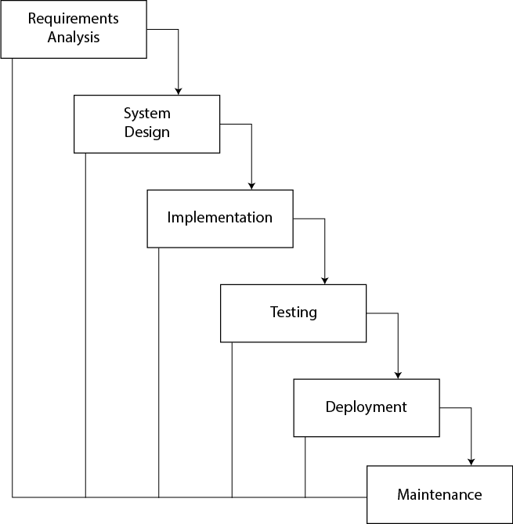
Waterfall Model
Methodology [1]

Slide 11
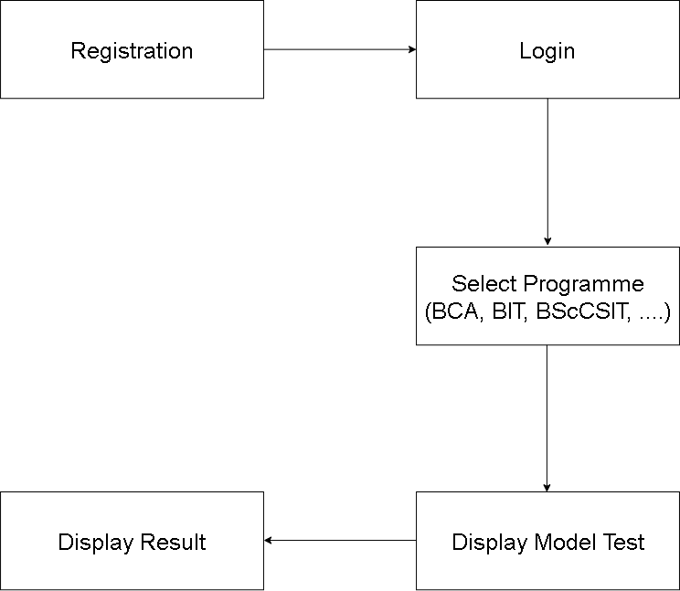
Methodology [2]
Block Diagram

Slide 12
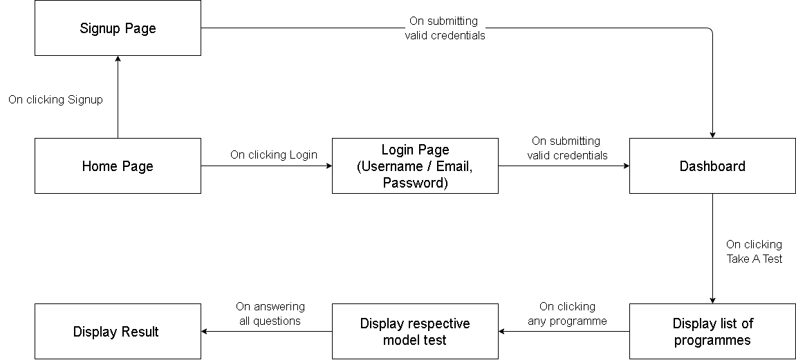
Methodology [3]
Architectural Diagram

Slide 13
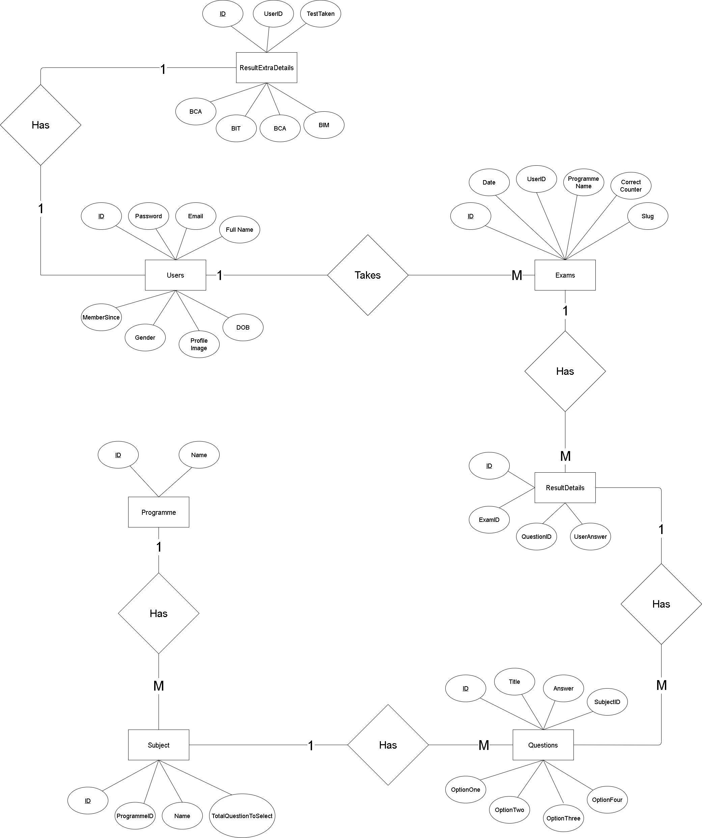
Methodology [4]
ER Diagram

Slide 14
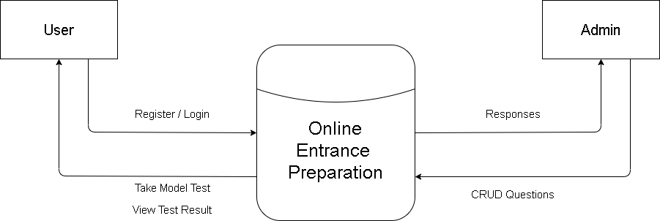
Methodology [5]
DFD-0 Level

Slide 15
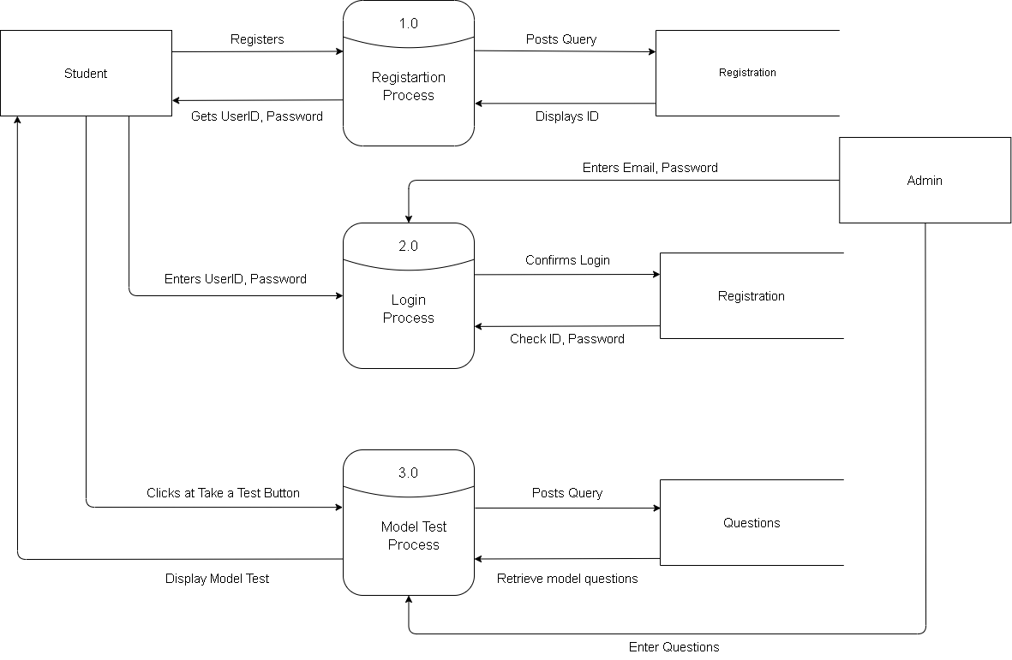
Methodology [6]
DFD-1 Level

Slide 16
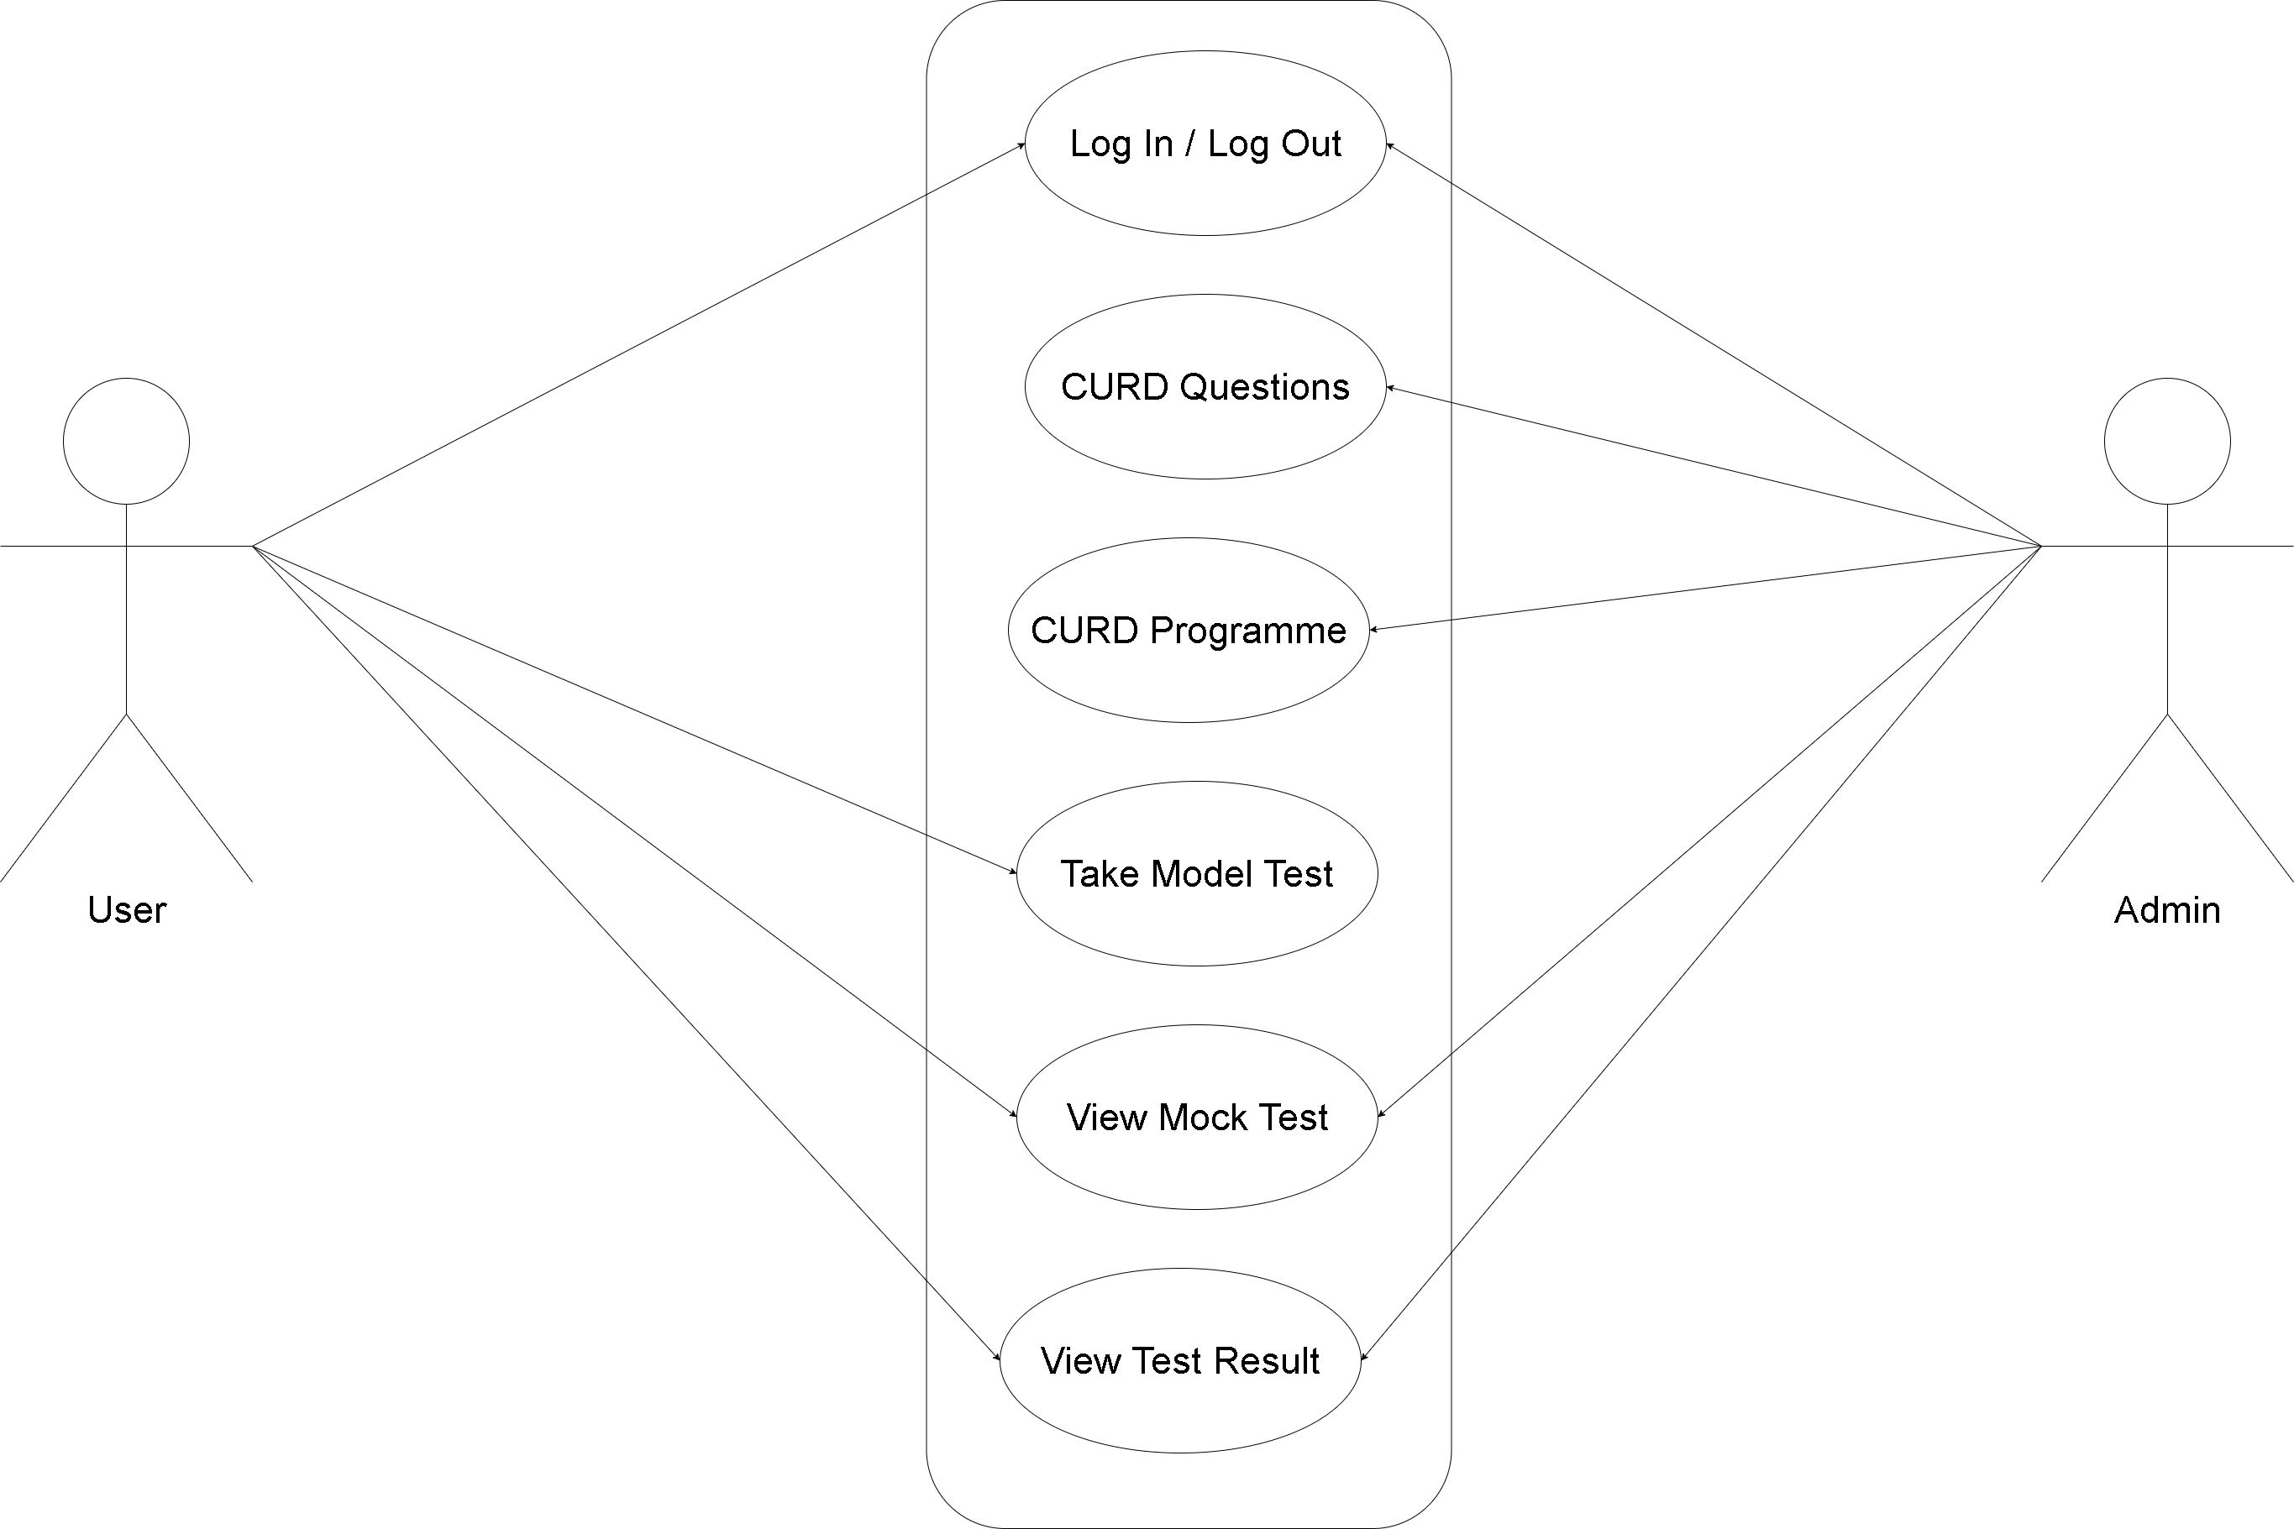
Methodology [7]
Use Case Diagram

Slide 17
Methodology [8]
Instrumentation Requirements
Hardware Requirements
RAM: 2GB and above
Processor: 1 GHz
Storage: 5 GB
Software Requirements
Python: 3.10.x and above
Django: 4.2 and above

Slide 18
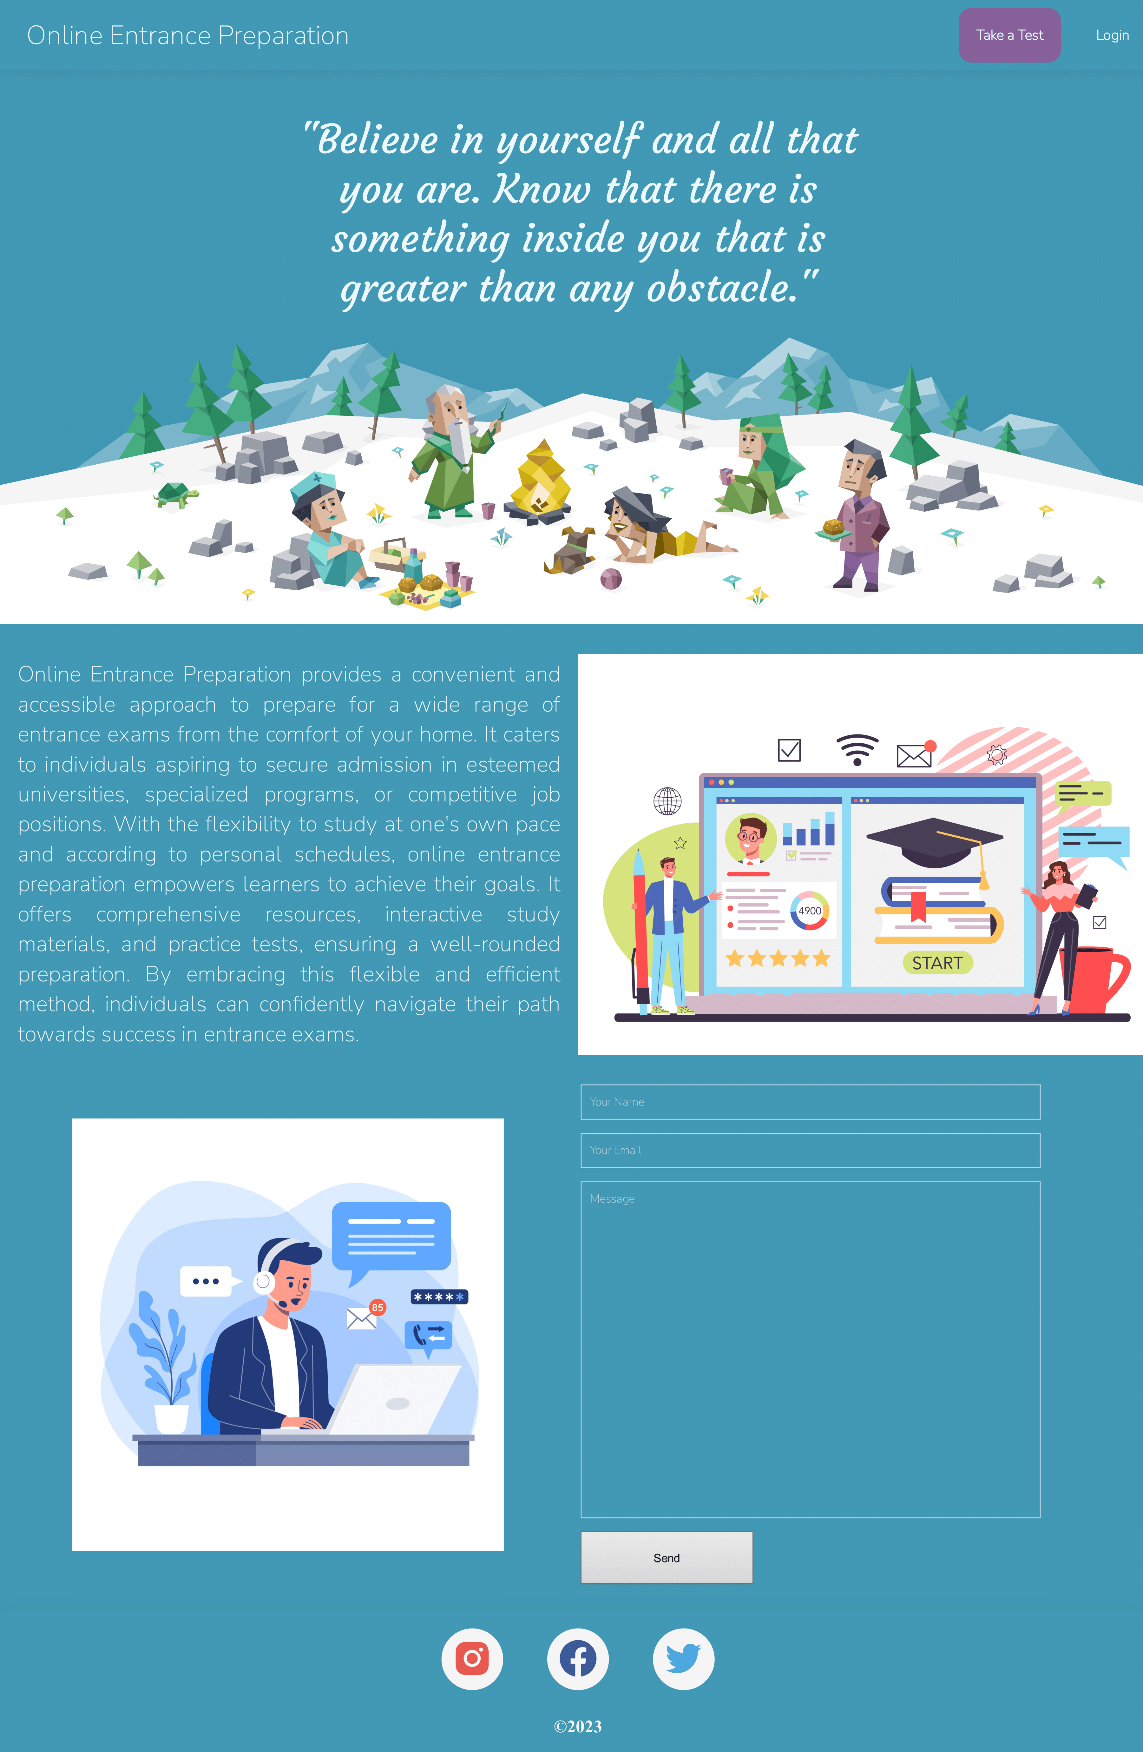
Result [1]
Home Page

Slide 19
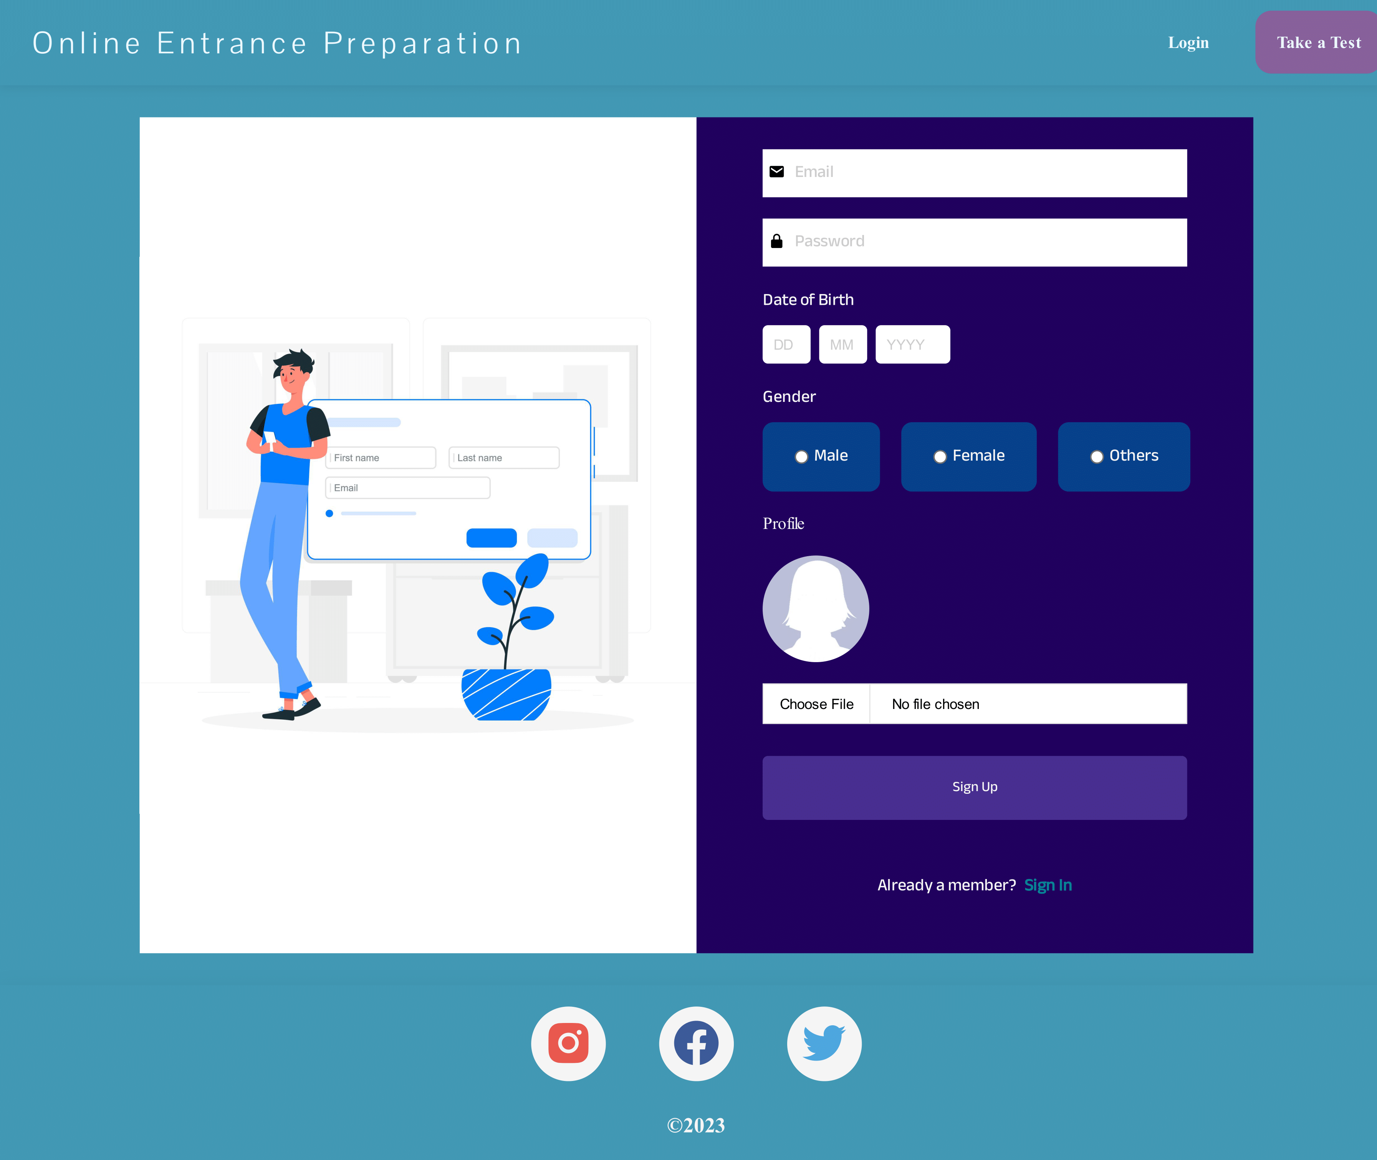
Result [2]
Registration Page

Slide 20
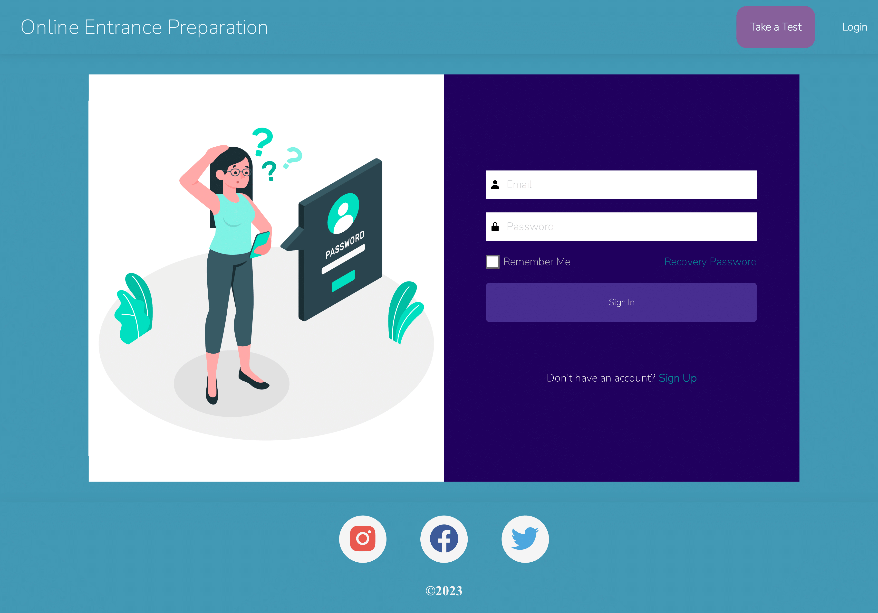
Result [3]
Login Page

Slide 21
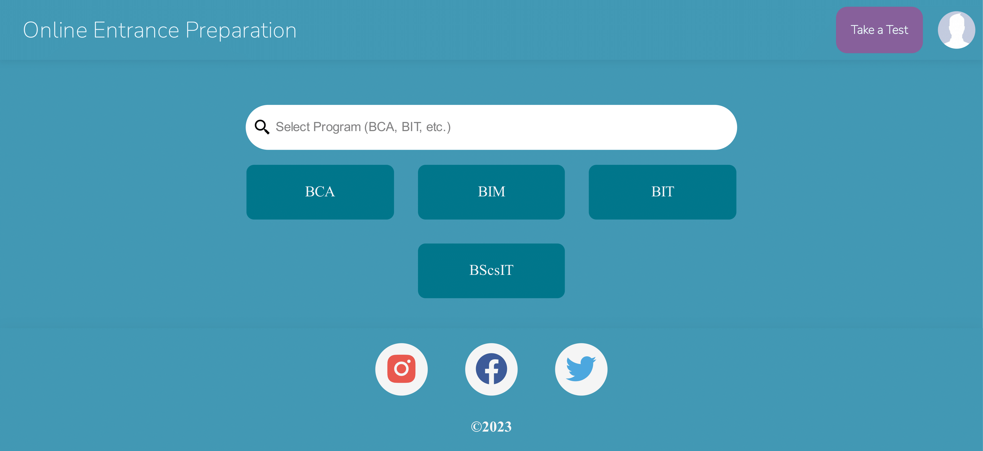
Result [4]
Programme selection Page

Slide 22
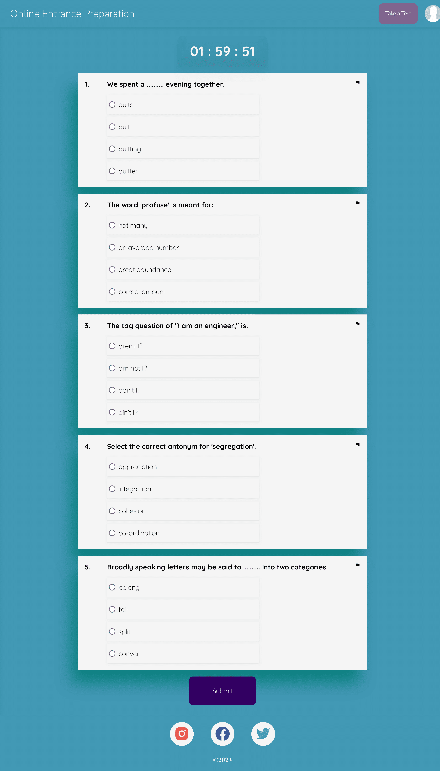
Result [5]
Take a Test

Slide 23
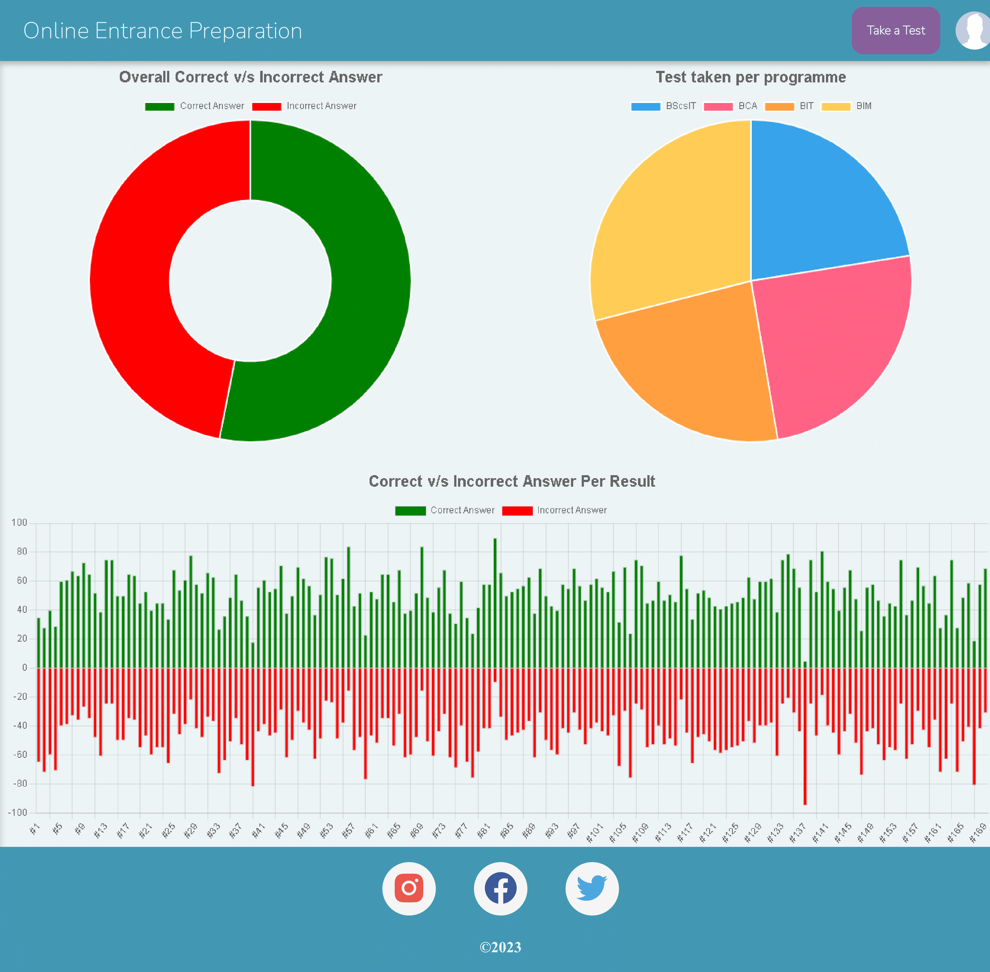
Result [6]
User’s Dashboard

Slide 24
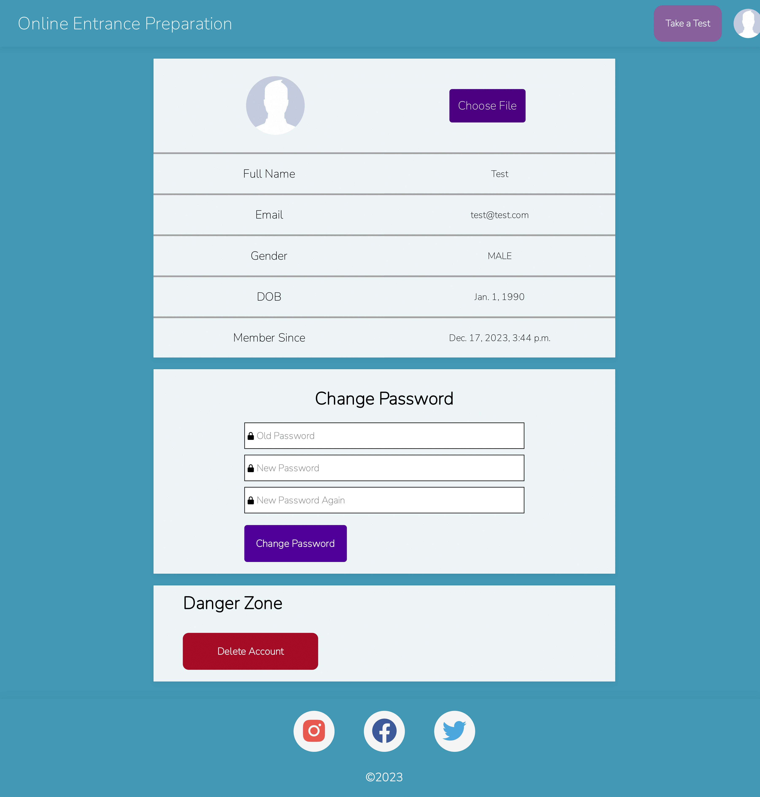
Result [7]
User’s Profile

Slide 25
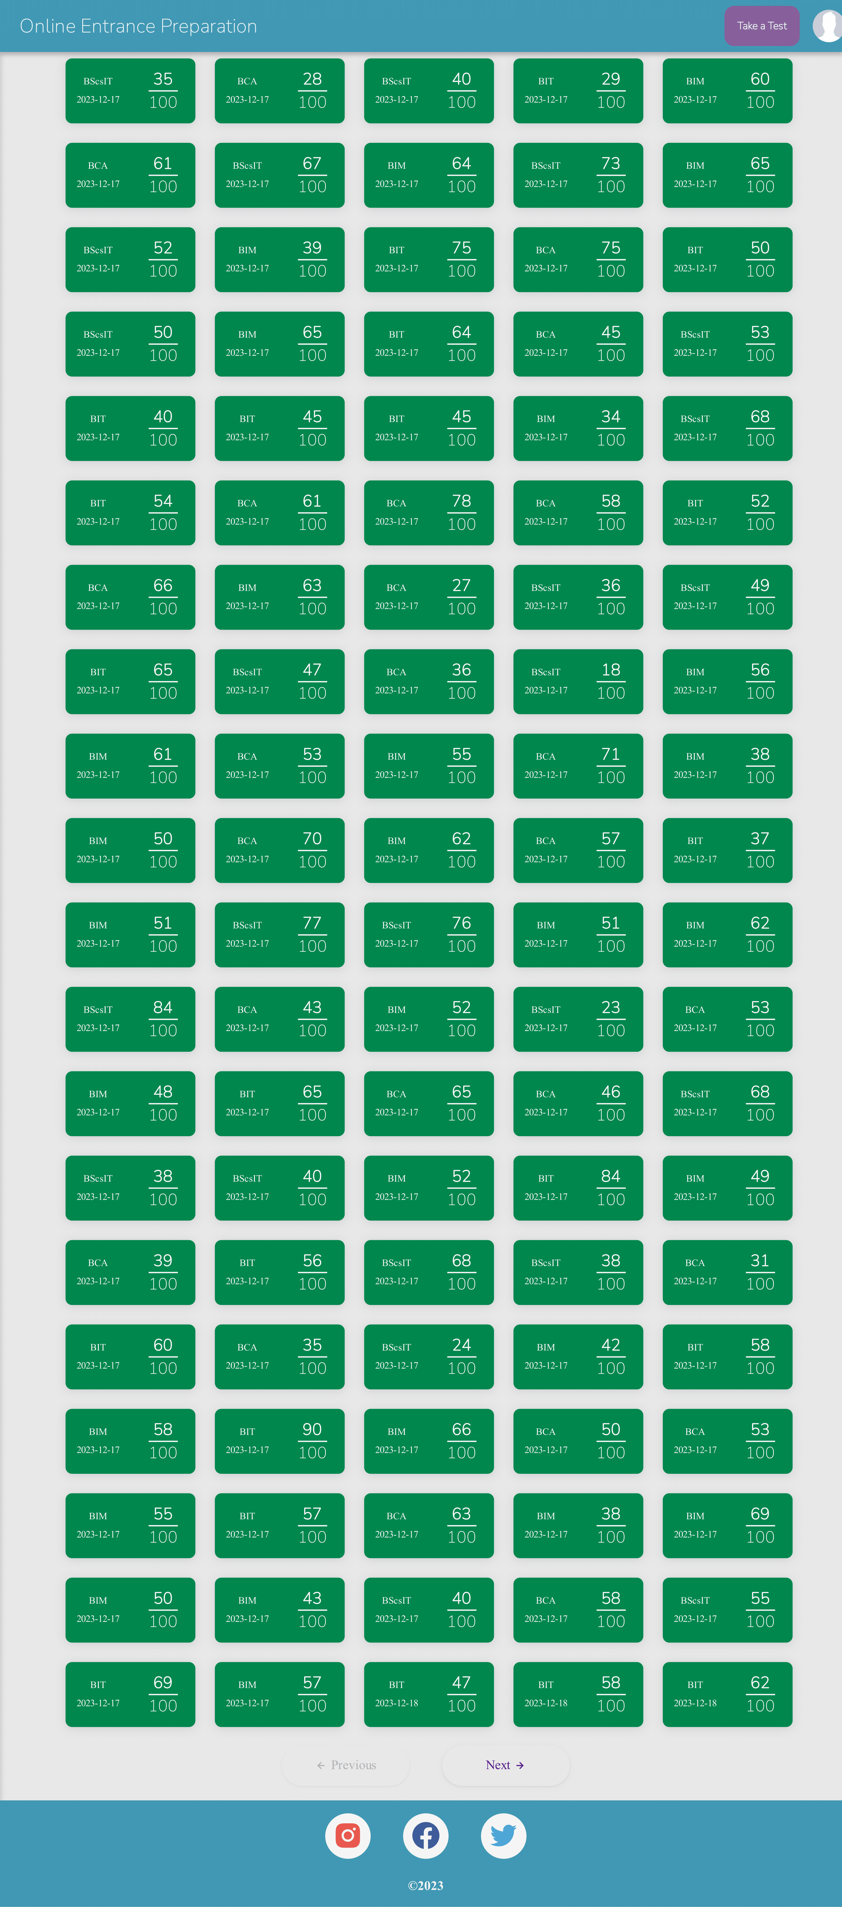
Result [8]
User’s History

Slide 26
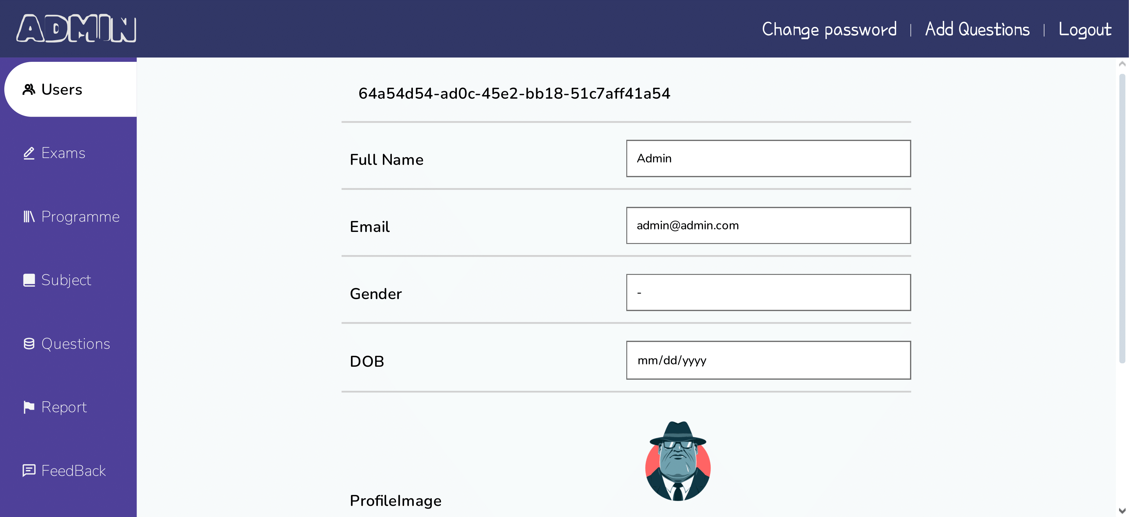
Result [9]
Admin – User Lists

Slide 27
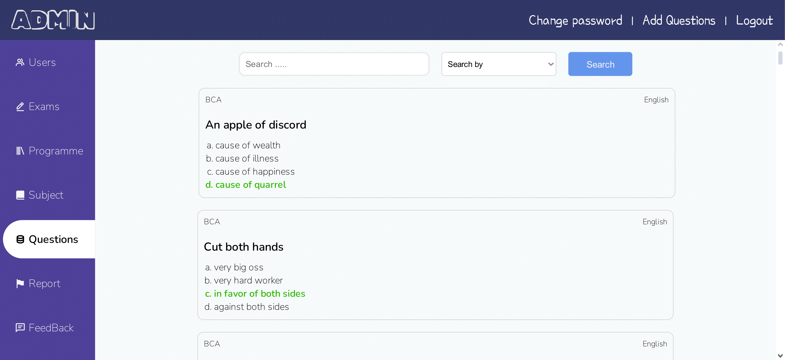
Result [10]
Admin – Question Lists

Slide 28
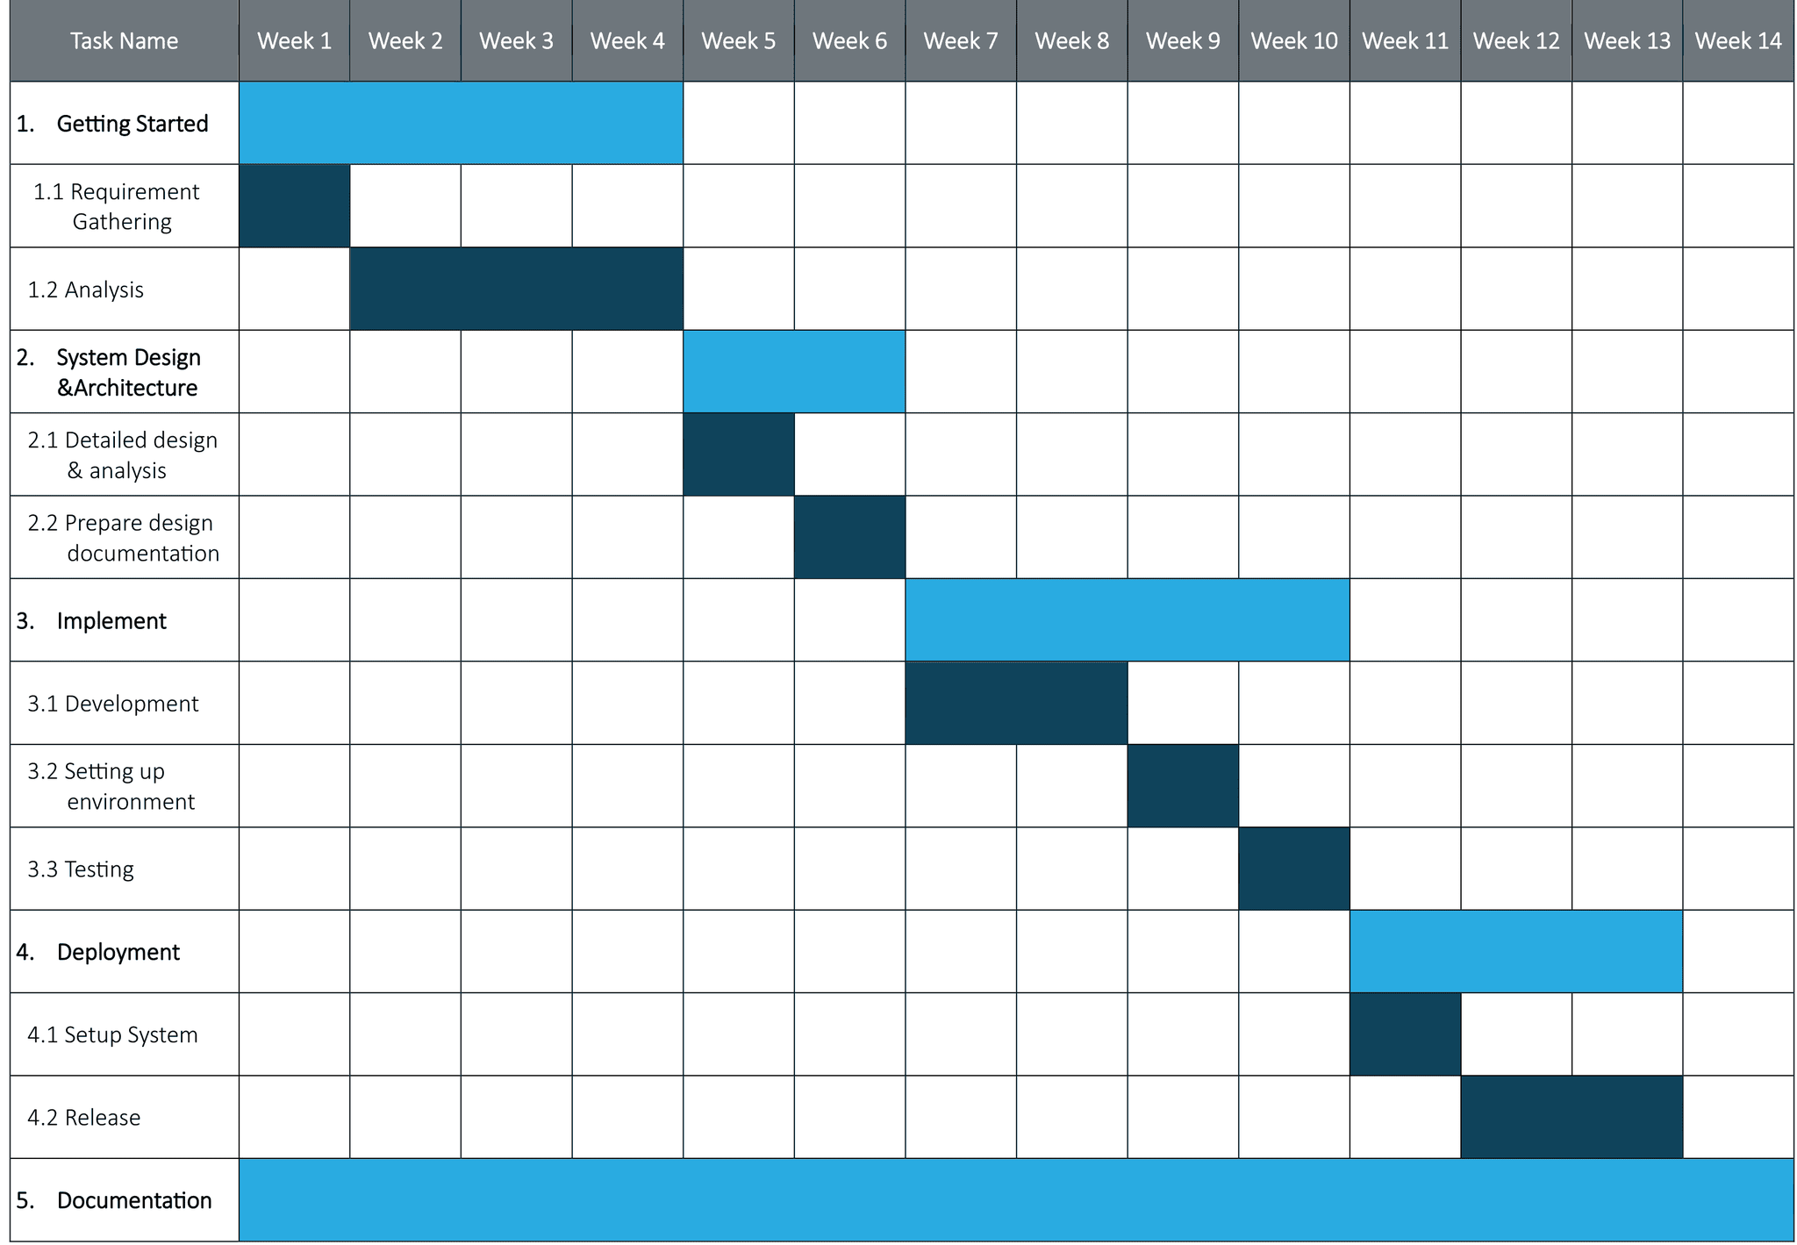
Gantt Chart

Slide 29
Conclusion
Online study websites revolutionize exam preparation with specialized questions for various courses, allowing flexible, self-paced study without the need for in-person classes.
These online resources offer tailored question sets for different courses, providing convenient, device-based study options and eliminating the need for heavy books and extensive material searches.
Online entrance prep websites offer flexibility and convenience, allowing students to study anytime, anywhere, making them a fantastic resource for upcoming entrance exams.

Slide 30
Future Recommendations
• Enable users to log in using social media accounts for a smoother experience.
• Implement phone numbers for registration, improving the registration process.
• Integrate multimedia for interactive learning.
• Provide personalized guidance with program-specific entrance notes for users

Slide 31
References
Nepaeducation, Nepal Entrance - Online Entrance Preparation in Nepal Available: https://www.nepaeducation.com
EntrancePedia, Online Entrance Preparation Available: https://www.nepalentrance.com
EntrancePedia, Online Entrance Preparation Available: https://www.entrancepedia.com
EngineeringDote, Online Entrance Preparation Platform for IOE Available: https://www.engineeringdote.com
Amir Maroof Khan, Somdatta Patra, Piyush Gupta, Arun Kumar Sharma, and Anil K Jain. “Rapid transition to online teaching program during covid-19 lockdown”, 2021

